Slide 1
Competing with
Information Technology

Slide 2
Learning Objectives
Identify several basic competitive strategies and explain how a business can use IT to confront the competitive forces faced by a business
Identify several strategic uses of IT and give examples of how they give competitive advantages to a business
Give examples of how business process reengineering frequently involves the strategic use of IT
Identify the business value of using Internet technologies to become an agile competitor or to form a virtual company

Slide 3
Strategic IT
Technology is no longer an afterthought in business strategy, but the cause and driver
IT can change the way businesses compete
A strategic information system is any information system that uses IT to help an organization…
  Gain a competitive advantage
  Reduce a competitive disadvantage
  Or meet other strategic enterprise objectives

Slide 4
Competitive Forces
To succeed, a business must develop strategies to counter these forces…
  Rivalry of competitors within its industry
  New entrants into an industry and its markets
  Substitute products that may capture market share
  Bargaining power of customers
  Bargaining power of suppliers

Slide 5
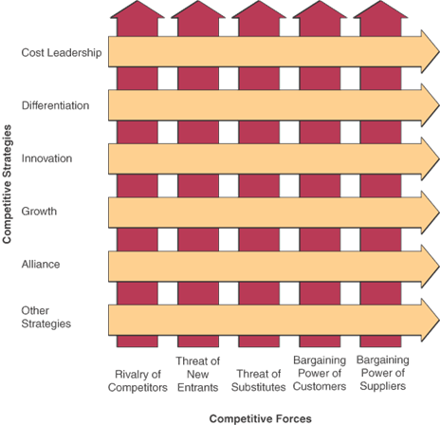
Competitive Forces and Strategies
Ref: Chapter 2 Competing with Information Technology

Slide 6
Five Competitive Strategies
Cost Leadership
  Become low-cost producers
  Help suppliers or customers reduce costs
  Increase cost to competitors
    Example: Priceline uses online seller bidding so the buyer sets the price
Differentiation Strategy
  Differentiate a firm’s products from its competitors’
  Focus on a particular segment or niche of market
    Example: Moen uses online customer design
Chapter 2 Competing with Information Technology
Notes:
https://www.moen.com

Slide 7
Competitive Strategies (cont’d)
Innovation Strategy
  Unique products, services, or markets
  Radical changes to business processes
    Example: Amazon’s online, full-service customer systems
Growth Strategy
  Expand company’s capacity to produce
  Expand into global markets
  Diversify into new products or services
    Example: Wal-Mart’s merchandise ordering via global satellite tracking
Chapter 2 Competing with Information Technology

Slide 8
Competitive Strategies (cont’d)
Alliance Strategy
  Establish linkages and alliances with customers, suppliers, competitors, consultants, and other companies
  Includes mergers, acquisitions, joint ventures, virtual companies
    Example: Wal-Mart uses automatic inventory replenishment by supplier
Chapter 2 Competing with Information Technology

Slide 9
Using Competitive Strategies
These strategies are not mutually exclusive
  Organizations use one, some, or all
  A given activity could fall into one or more categories of competitive strategy
Not everything innovative serves to differentiate one organization from another
  Likewise, not everything that differentiates organizations is necessarily innovative
Chapter 2 Competing with Information Technology

Slide 10
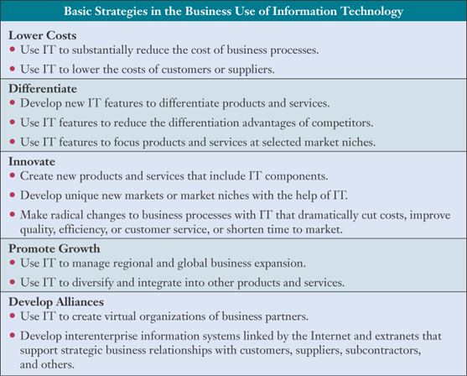
Ways to Implement Basic Strategies
Chapter 2 Competing with Information Technology

Slide 11
Customer-Focused Business
What is the business value in being customer-focused?
  Keep customers loyal
  Anticipate their future needs
  Respond to customer concerns
  Provide top-quality customer service
Focus on customer value
  Quality, not price, has become the primary determinant of value
  Consistently
Chapter 2 Competing with Information Technology

Slide 12
Providing Customer Value
Companies that consistently offer the best value from the customer’s perspective…
  Track individual preferences
  Keep up with market trends
  Supply products, services, and information anytime, anywhere
  Tailor customer services to the individual
  Use Customer Relationship Management (CRM) systems to focus on the customer
Chapter 2 Competing with Information Technology

Slide 13
Strategic Uses of IT
A company that emphasizes strategic business use of IT would use it to gain a competitive differentiation
  Products
  Services
  Capabilities
Chapter 2 Competing with Information Technology

Slide 14
Reengineering Business Processes
Called BPR or simply Reengineering
  Fundamental rethinking and radical redesign of business processes
  Seeks to achieve improvements in cost, quality, speed, and service
Potential payback is high, but so is risk of disruption and failure
Organizational redesign approaches are an important enabler of reengineering
  Includes use of IT, process teams, case managers
Chapter 2 Competing with Information Technology

Slide 15
The Role of IT
IT plays a major role in reengineering most business processes
  Can substantially increase process efficiencies
  Improves communication
  Facilitates collaboration
Chapter 2 Competing with Information Technology

Slide 16
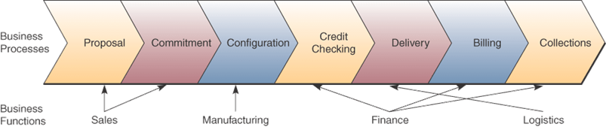
A Cross-Functional Process
Many processes are reengineered with…
  Enterprise resource planning software
  Web-enabled electronic business and commerce systems
Chapter 2 Competing with Information Technology

Slide 17
Reengineering Order Management
IT that supports this process…
  CRM systems using intranets and the Internet
  Supplier-managed inventory systems using the Internet and extranets
  Cross-functional ERP software to integrate manufacturing, distribution, finance, and human resource processes
  Customer-accessible e-commerce websites for order entry, status checking, payment, and service
  Customer, product, and order status databases accessed via intranets and extranets
Chapter 2 Competing with Information Technology

Slide 18
Becoming an Agile Company
Agility is the ability to prosper
  In rapidly changing, continually fragmenting global markets
  By selling high-quality, high-performance, customer-configured products and services
  By using Internet technologies
Chapter 2 Competing with Information Technology

Slide 19
Strategies for Agility
An agile company…
  Presents products as solutions to customers’ problems
  Cooperates with customers, suppliers and competitors
  Brings products to market as quickly and cost-effectively as possible
  Organizes to thrive on change and uncertainty
  Leverages the impact of its people and the knowledge they possess
Chapter 2 Competing with Information Technology

Slide 20
Creating a Virtual Company
A virtual company uses IT to link…
  People
  Organizations
  Assets
  Ideas
Inter-enterprise information systems link…
  Customers
  Suppliers
  Subcontractors
  Competitors
Chapter 2 Competing with Information Technology

Slide 21
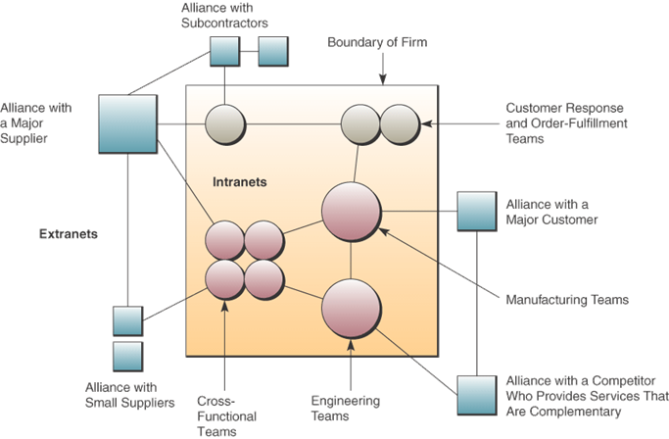
A Virtual Company
Chapter 2 Competing with Information Technology

Slide 22
Virtual Company Strategies
Basic business strategies
  Share information and risk with alliance partners
  Link complimentary core competencies
  Reduce concept-to-cash time through sharing
  Increase facilities and market coverage
  Gain access to new markets and share market or customer loyalty
  Migrate from selling products to selling solutions
Chapter 2 Competing with Information Technology

